Slide 1
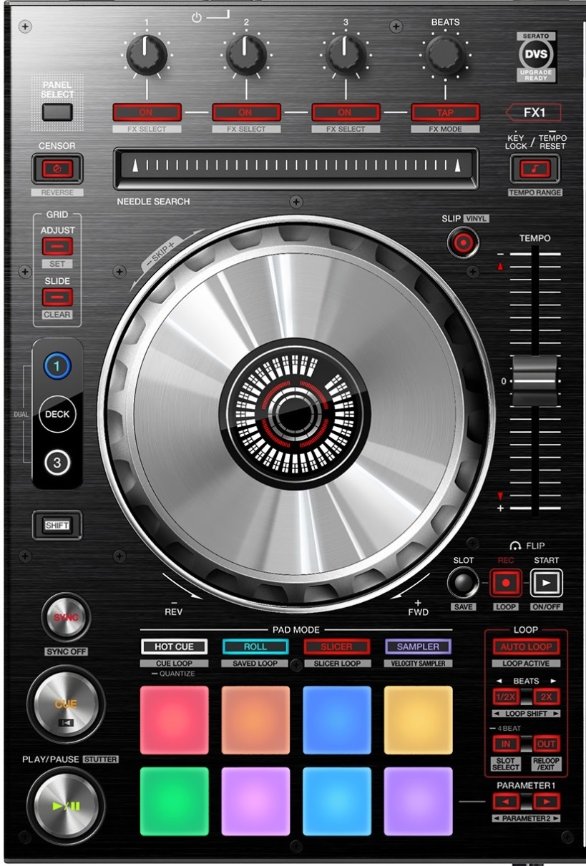
DDJ-SX2: General overview #1
Dry Wet / Toggle all FX units
Select FX
Turn FX off
TP3 Slip Reverse
Keylock / 6%->10%->16%->100%
BPM Slide / Set Marker / Auto
Slip / CDJ mode)
BPM Adjust / Reset Marker / Lock
JogFX / Quick Search
CDJ / Grid Adjust
Second shift
/ Layout change
Main shift
Loop recorder functions
Sync Force / Sync Off / Master
4-beat Loop / Active Loop / Move 1-beat
LoopSize / MoveSize / BeatJump
Track begin
Vinyl Stop / Release FX
Shortcut to JogFX
Sortcut to MacroFX /
Cycle page

Slide 2
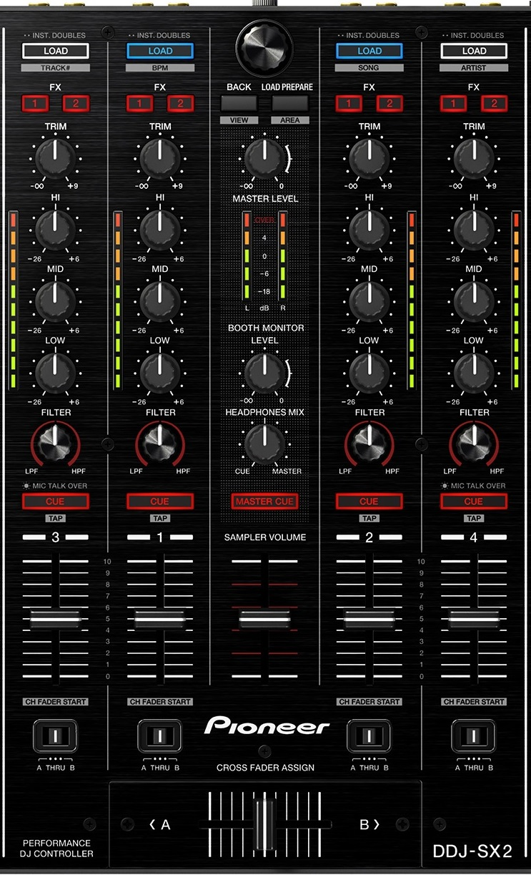
DDJ-SX2: General overview #2
List Browse / Tree Browse Zoom / Preview player
Only Browser (toggle)
Preview Player
(using browser)
MacroFX / MixerFX
JogFX+MacroFX DryWet

Slide 3

DDJ-SX2: Pad modes
Each mode has several sub-pages, accessible using shift.
Press “<” to access MacroFX mode
Press “<” to cycle the top 2x pages
Press “>” to access JogFX mode
Roll (4 pages)
Slicer
Hot Cues / Cancel JogFX
Remix decks
MacroFX (3 pages)
Remix decks (Velocity)
Quantize + Snap (toggle)
Jog FX
Pad FX (3 pages)
Shortcut to JogFX
Sortcut to MacroFX /
Cycle page

Slide 4
DDJ-SX2: Details
Regular: Browse List
+shift: Browse Tree
+Memory: Zoom
+Back: Preview seek
Press: Load
+shift: Open folder
+memory: Auto-zoom
Second shift
Main shift
Load Preview player
Only browser
regular: LoopSize
+shift: MoveSize
+memory: BeatJump
+memory +shift: IN/OUT
Regular: 4-Loop
+shift: Selected Loop
+memory: 1-Move
+memory +shift: Activate
regular: Sync Force
+shift: Sync Off
+memory: Master
regular: Cue
+shift: Move to font
+shift: BPM set
+Jog: grid slide
+Key reset: BPM Auto
Regular: Pause
+shift: Vinyl quick stop
+memory: Vinyl long stop
+shift: BPM delete
+Jog: grid adjust
+Key sync: Analysis Lock

Slide 5
DDJ-SX2: JogFX
Jog FX
Jog FX
Beatmasher / Digital filter / Gater
Beatmasher / Filter / Reverb
Event Horizon / Gater
Gater / Beatmasher / Reverb
Jog FX
Flanger / Gater
Beatmasher / Peak filter / Gater
FormatFilter / Peak filter / Flightest

Slide 6
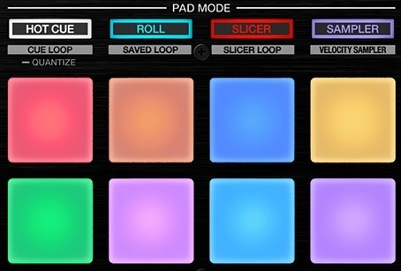
DDJ-SX2: MacroFX
MacroFX
MacroFX: WormHole
MacroFX: PolarWind
MacroFX: FlightTest
MacroFX: LaserSlicer
BeatFX: Delay T3
BeatFX: Flanger
BeatFX: Reverb
Toggle On/OFF
Event Horizon
MacroFX: Zzzuurp
Dark
Matter
Bass-O-Matic
MixerFX: Flanger
MixerFX: TimeGater
MixerFX: Noise
MixerFX: Crush
MacroFX (twice=cycle)
Strrretch (Slow)
Strrretch (Fast)
Granu Phase
Toggle On/OFF
Filter

Slide 7
DDJ-SX2: PadFX
PadFX
Gater #1
Gater #2
Gater #3
Peak Filter
Beat
Masher #1
Beat
Masher #2
Zzzurp
Release FX (toggle)
Delay #1
Delay #1
Delay / BeatSlicer
Flanger Flux
Filter Pulse
LaserSlicer
Bass-O-Matic #1
Bass-O-Matic #2
Lofi / Slicer #1
Lofi / Slicer #2
BeatSlicer
Release FX (toggle)
Bouncer / EventH
Bouncer
EventH
Release FX (toggle)

Slide 8
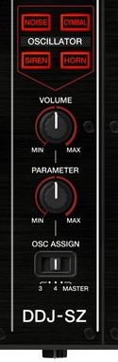
DDJ-SZ: specific buttons
MixerFX selection
(To be done)
Keep at zero!
Beat FX Dry/Wet
Keep at “4”

